Slide 1
KS2 SATS 2024/25
St James Catholic Primary School
Parents and teachers working together for the benefit of the children.

Slide 2
How are we preparing?
Focused lessons ensuring that all content of the Y6 curriculum is covered.
Intervention sessions for children who require extra support or extension.
Booster sessions after school.
Encouraging the use of SATs Boot Camp
Familiarisation of SATS questions.
Regular target setting and monitoring.
Support of mental health and well being.

Slide 3
WHAT WILL BE ASSESSED?
ASSESSED BY TESTS (marked externally)
PAPER 1
PAPER 2
PAPER 3
* No Calculators
ONE PAPER
GRAMMAR PUNCTUATION AND SPELLING TWO PAPERS
MATHS
READING
GPS
CONTINUOUS ASSESSMENT
WRITING
CONTINUOUS ASSESSMENT
SPEAKING & LISTENING

Slide 4
MATHS 2024/25
MATHS (marked externally)
PAPER 1
Arithmetic
Lasts for 30 minutes.
PAPER 2
Reasoning
PAPER 3
Reasoning
Lasts for 40 minutes.
Lasts for 40 minutes
The tests have questions of 1 and 2 marks and children are given marks for working out if they finish the task but get the answer incorrect. Couple of 3-mark questions in there too.

Slide 5
36Q in 30 minutes

Slide 7
READING 2024/25
PAPER 1
There is only one paper based on reading comprehension of three to four different, un-linked texts, with a total of 35 to 40 questions. (Totalling 50 marks)
The least demanding texts will come first with the following texts increasing in level of difficulty. Questions worth 1,2,or 3 marks each.
Lasts for 1 hour (no ‘reading time’ to start)
(marked externally)

Slide 8
Reading Test Examples
Some questions will ask the children to find answers directly from the reading booklets they are given.

Slide 9
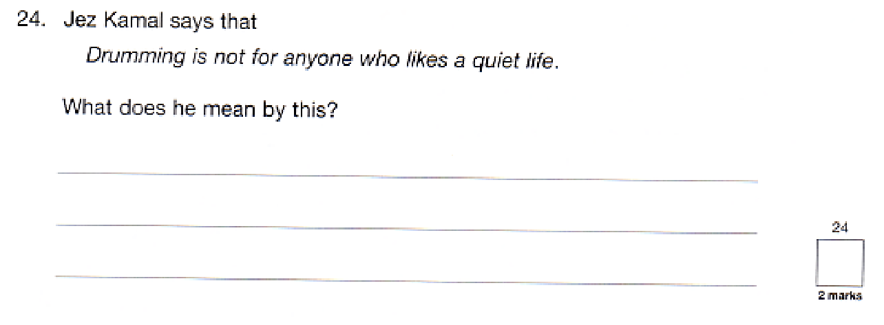
Others will require the children to deduce answers by using words or phrases as evidence.

Slide 10
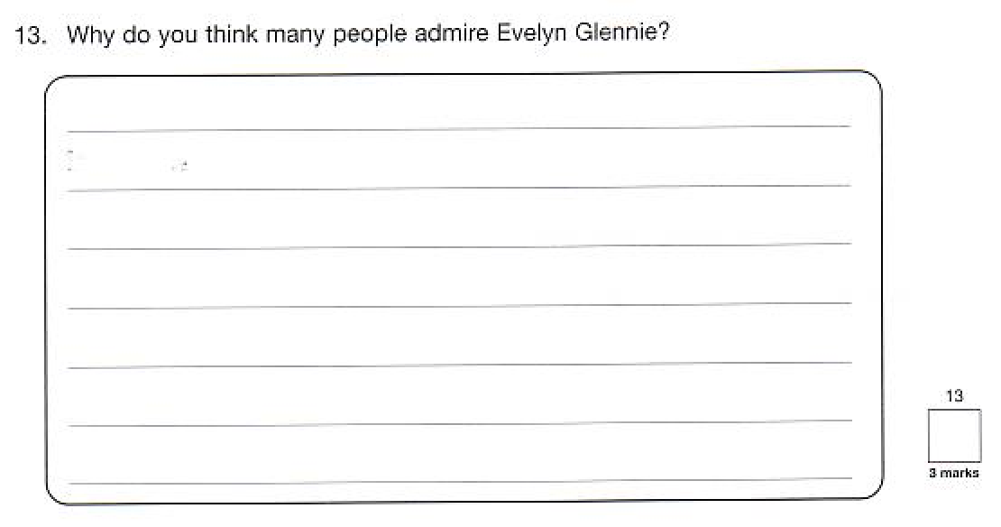
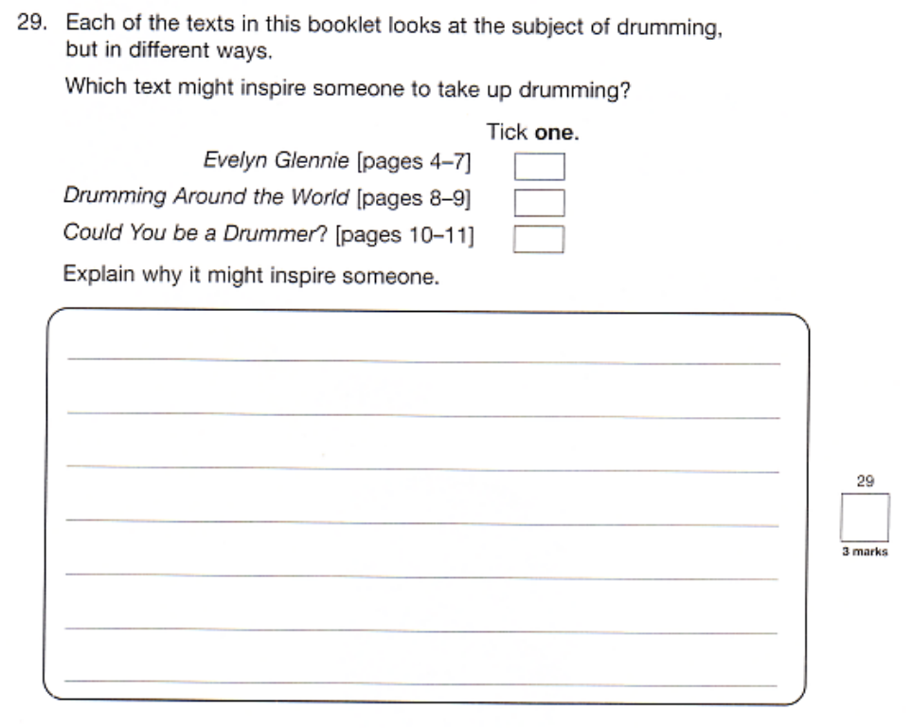
Some questions will ask the children to evaluate what they have read, again using the text to back up their answers.

Slide 11
SPaG 2024/25
English - Grammar, Punctuation and Spelling
PAPER 1
Comprises 40 to 50 short-answer questions covering grammar, punctuation and vocabulary.
A spelling test with 20 questions.
(marked externally)
PAPER 2

Slide 12
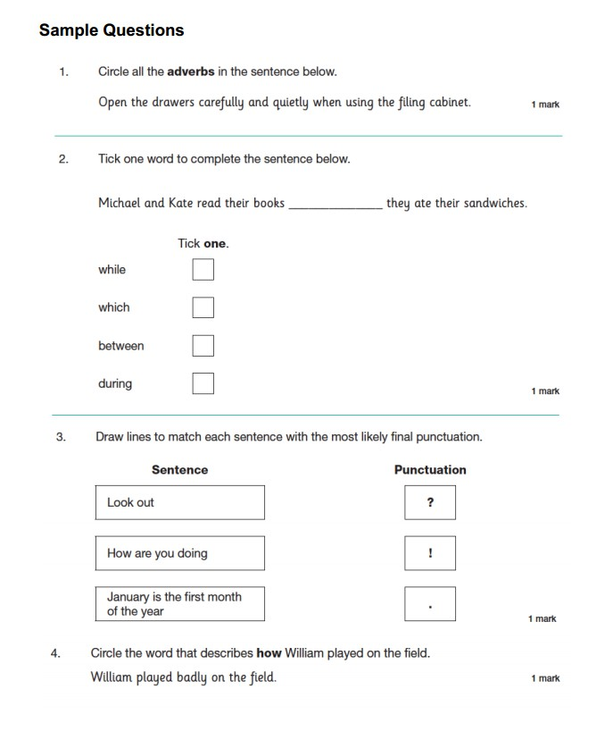
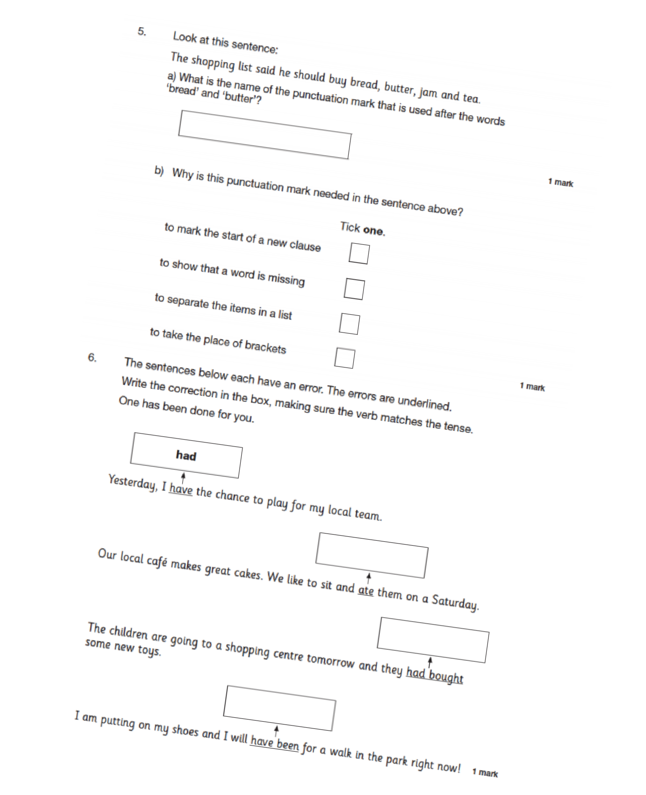
Sample questions

Slide 13
WRITING 2024/25
Teachers will assess children’s writing composition. children’s results for English writing will be a judgement of their work across Year 6.
Children's grammar, punctuation and spelling skills will be assessed as part of their writing, but their creativity and writing style will also be evaluated.
Schools will moderate their judgements with other local schools and may be moderated by their Local Authorities too.

Slide 14
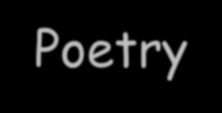
What is assessed in writing?
Composition and Effect
Text Organisation
Sentence structure and Punctuation
Spelling and Handwriting
Children are expected to be able to write using a range of different genres including:
Newspaper report
Biography
Autobiography
Diary Entry
Narrative
Formal letter
Informal letter
Report
Recount
Balanced argument
Advert
Instructions
Play script
Poetry

Slide 15
SAT SCALES
The expected standard in each subject is 100.
Your child will receive a raw score and a standardised score.
The DFE will wait until pupils have taken the tests before setting the national standard.
Lowest score is 80 and the highest is 120.

Slide 16
In 2022 to get an expected standard (100) in the mathematics test the children had to get a raw score 58 out of 120.
In 2022 to get an expected standard (100) in the reading test the children had to get a raw score of 29 out of 50.
In 2022 to get an expected standard (100) in GPS the children had to get a raw score of 35 out of 70.
These thresholds change each year.

Slide 17
In 2022 to get the greater depth standard (110) in the mathematics test the children had to get a raw score 96 out of 120.
In 2022 to get the greater depth standard (110) in the reading test the children had to get a raw score of 41 out of 50.
In 2022 to get the greater depth standard (110) in GPS the children had to get a raw score of 55 out of 70.

Slide 18
WHEN ARE THE TESTS?
All KS2 SATs will be held in the week beginning 12th May 2025
 | Monday 8th May | Grammar, Punctuation and Spelling Paper 1: questions Grammar, Punctuation and Spelling Paper 2: spelling
 | Tuesday 9th May | Reading
 | Wednesday 10th May | Mathematics Paper 1: Arithmetic. Paper 2: Reasoning
 | Thursday 11th May | Mathematics Paper 3: Reasoning
Date

Slide 19
SEND
Some support can be given to children who are on the SEND register. For example, some pupils may be given extra time to complete the tests.
An adult can help a child to read instructions on the reading
test.
An adult can read questions on the grammar and maths test.
Children with visual impairment can have enlarged or brailed copies of the test.
Children who do not have English as a first language can have
a translator for maths.

Slide 20
REPORTING RESULTS
Children’s progress, as well as their achievement, will be measured and reported on in school performance tables.
Teacher assessments will be passed on to secondary schools so they can be used in planning for Year 7 teaching.
The results will be emailed to school mid July.
Results will be given to children in their end of year
report.

Slide 21
HELPING AT HOME
Learning spellings.
Encourage completion of homework on SATs Bootcamp and support targets that have been discussed at Parents Evenings.
Encourage regular reading.
Use interactive programs provided by the school such as Times Tables Rock Stars and SATS Boot Camp.
Encourage, praise and reward.

Slide 22
WE RECOMMEND:-
early nights using technology wisely
regular attendance good punctuality
a healthy diet and exercise regular hydration
rest when you can

Slide 23
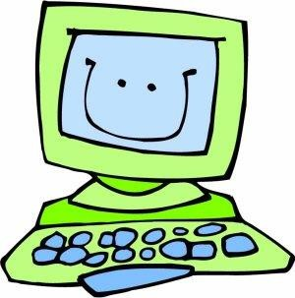
USEFUL WEBSITES
BBC Bitesize – for sheer ease of use and clarity of content, we recommend the BBC’s vast range of resources for Key Stage 2 SATs revision. Click here for maths and click here for English.
2. Primary Homework Help – this website (from Woodlands Junior School in Kent) is packed with engaging, fun activities that are absolutely relevant to Key Stage 2 SATs revision.
3. SATs Papers– this one is for parents and carers. The SATs website has information and guidance on procedures. Comprehensive and concise, it’s a useful reference tool. You can also buy practice papers on this site.
4. The internet is full of examples of hard working teachers who go the extra mile, and Mr Pitts is a brilliant example of professional dedication. His numeracy website is impeccable – take a look.
5. For spelling practice, the ICT Games website offers an automated Look, Cover, Write, Check word bank. This is really useful for brushing up on Key Stage 2 spellings. You can choose a year group, then pick ‘tricky words’ or ‘patterns’.
6. We love this story about a Year 6 teacher who sets fun homeworks to help her Year
6 class avoid stress. It’s the perfect attitude for Key Stage 2 SATs revision.

Slide 24
AND FINALLY
Keep a positive outlook – they’re just a couple of tests!
This is year is about your own personal journey. Make it all about you.
Slow and steady wins the race – slowly chip away at the bigger things and the rest will come easy.
Little and often will help you get through a challenging year. Don’t leave it all to the last minute. Do a little each day and you will get your reward.
THANK YOU

Slide 25
Exam Stress
Healthy Minds Team

Slide 26
Exam Stress
Exams can be challenging and worrying times for some children.
Pressures of performing can lead to many children believing that they are only worthy as individuals if they get good exam results.

Slide 27
What are common signs of stress?
Worry
Irritability
Tiredness/ Fatigue
Feelings of worthlessness
Think that we “can’t cope” with what we have going on
Poor sleep
Poor concentration
Feeling tearful and angry

Slide 28
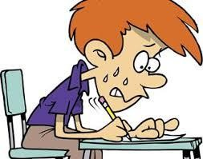
What is Stress
Stress is an automatic reaction in response to danger
Fight or flight is our body trying to keep us safe
More helpful in the past when humans faced more physical threat such as needing to escape predators…
…but not so much now…

Slide 29
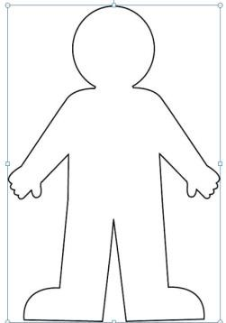
How Stress is maintained – Exam situation
Thoughts
I can't cope! What if I fail? I can't do this
What if my mind goes blank!
Physical symptoms
Fight or flight!
Heart palpitations Breathless Butterflies
Tired Drained
Behaviours
Put things off Comfort eat/eat less Sleep more/less Snap at others Avoidance
Tearful/ reassurance
seeking
Emotions Angry Frustrated Anxious Low mood Upset

Slide 30
Help your child beat exam stress
Watch for the signs of stress
Make sure your child eats well
Help your child get enough sleep
Be flexible during exams
Help them study
Talk about emotions and exam nerves
Encourage them to exercise during exams
Do not add pressure
Make time for treats
For more information on the above please follow the link Help your child beat exam stress - NHS (www.nhs.uk)

Slide 31
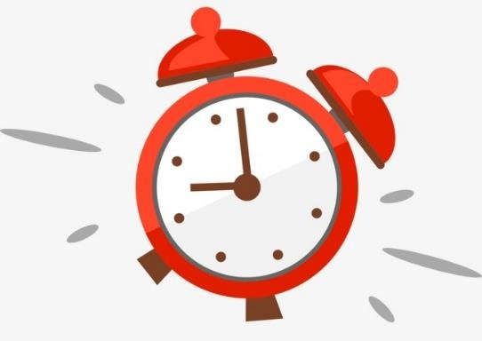
Setting realistic goals
Set realistic goals for your study session
e.g., 'I'll read this section,’ or ‘I’ll study for 40 minutes before I make that drink.‘
set an alarm or reminder if you have set a specific time so
you’re not tempted to clock watch
Remember that it is best to try and have short-term deadlines
e.g., setting a goal of finishing one section of an assignment
rather than the whole thing
Learn to prioritise your tasks
know your deadlines
Use visuals – calendars/timetables/post-it notes

Slide 32
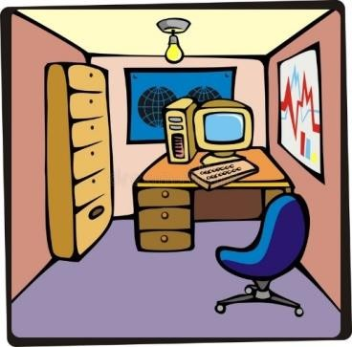
Distractions
Think about the best place where you get the most revision done
Pick somewhere with minimal distraction
Avoid phone, internet and other social distractions – put it out of sight!
Remove temptations!

Slide 33
Time Management
Using a weekly planner can help to keep you on track with what you need to do and when. A blank example is shown below.
This allows you to set specific goals not only for revision but for breaks and time away from study - This is called self care and it is important that you plan in ‘ME’ time to look after your body and mind.
 | Monday | Tuesday | Wednesday | Thursday | Friday | Saturday | Sunday
Morning
Afternoon
Evening
Enjoyment
Achievement

Slide 34
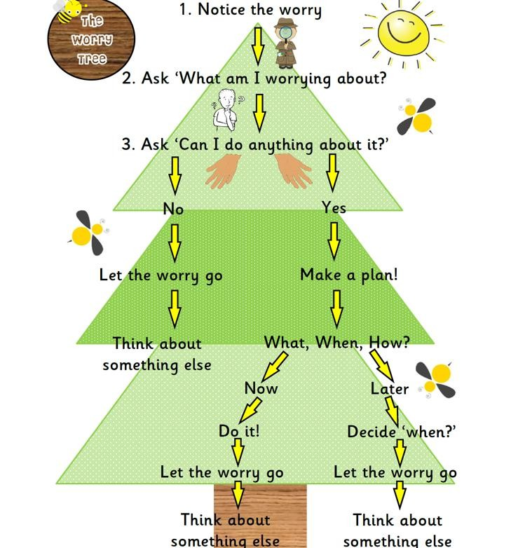
Managing Worry Worry Tree

Slide 35
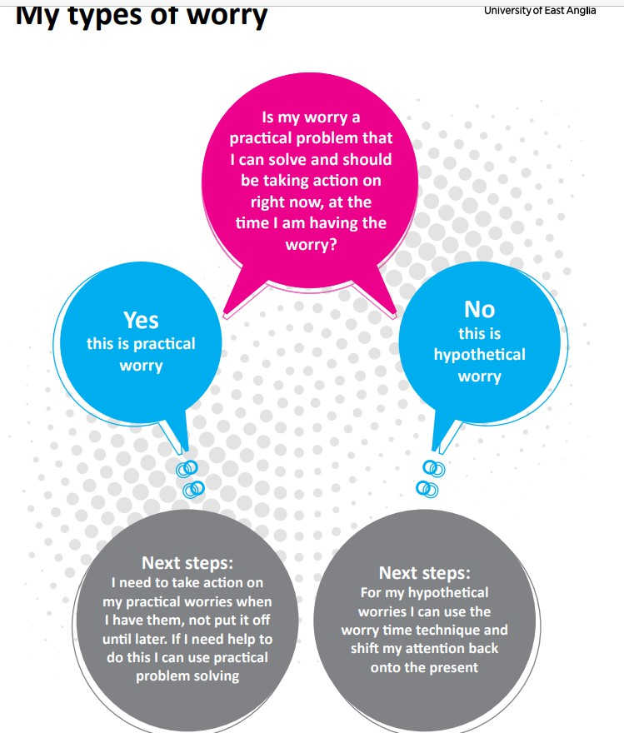
Types of Worries
There are two types of Worry
Practical worries – that we can use problem solving to help us solve these worries
Hypothetical worries - That we need to refocus our attention
else where – such as breathing or relaxation techniques

Slide 36
Problem Solving – My practical worry
Step 1
Turn your worry into a problem what do I need to do?
Step 2
List as many solutions as you can
write down every solution you can think of (even silly ones)

Slide 37
Problem Solving – My practical worry
Step 3
List the pros and cons of each solution you have produced
Then number them – 1 being the one you think is most likely to solve the problem you have
Solutions | Pros | Cons | Number
Step 4
Decide how to carry out your chosen
solution
what are you going to do? when are you going to do it? will anything get in your way? how will I overcome that?
Step 6
Carry out the plan………..

Slide 38
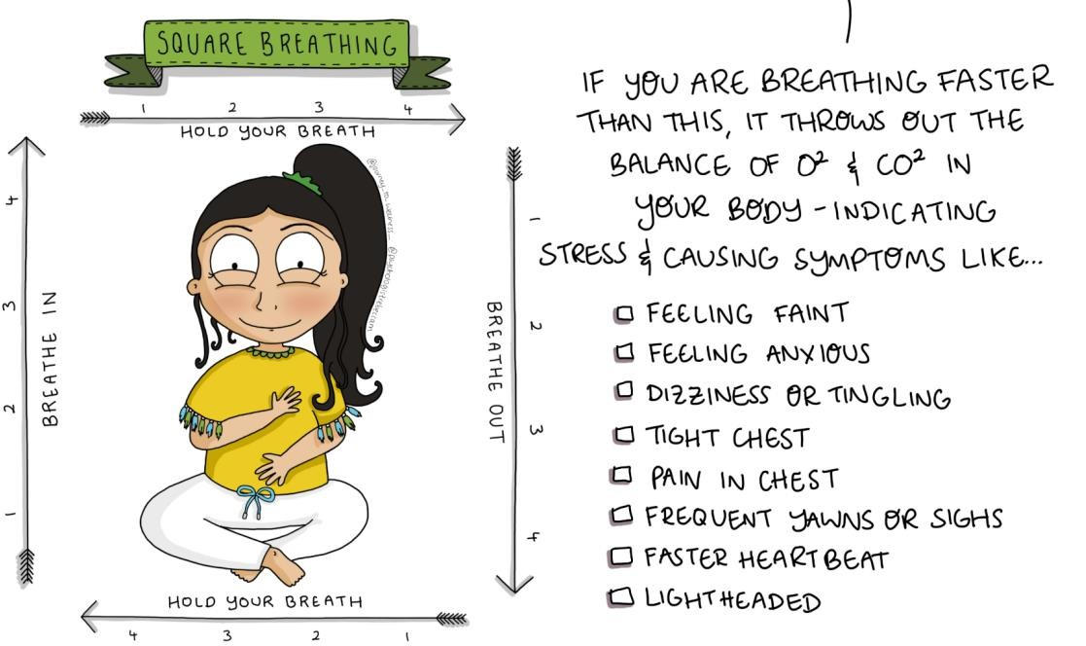
Relaxation and Breathing techniques
@journey_to_Wellness_

Slide 39
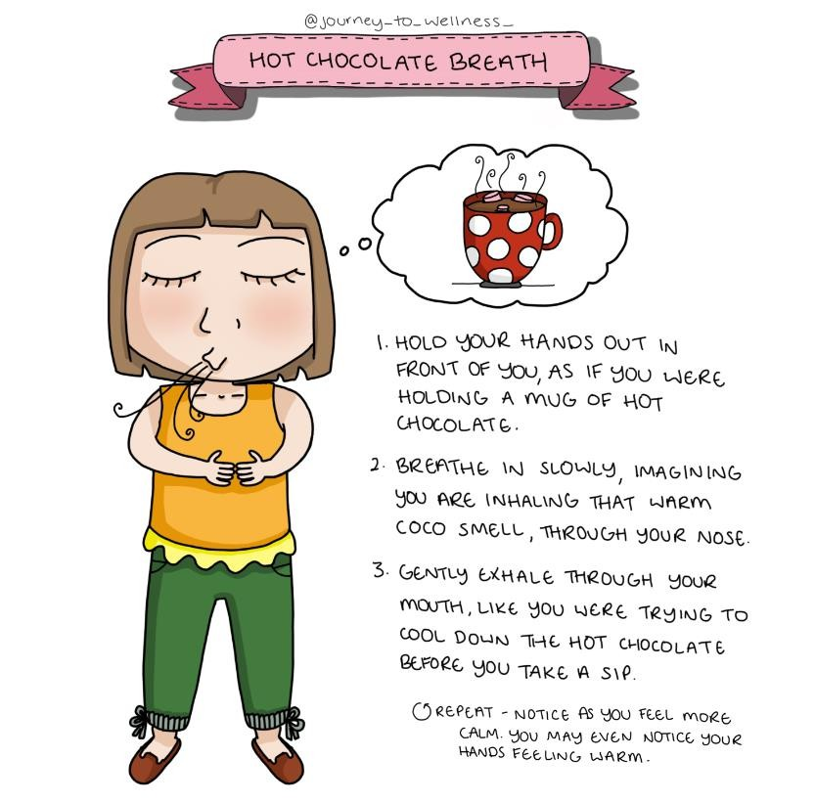
Relaxation and Breathing techniques

Slide 40
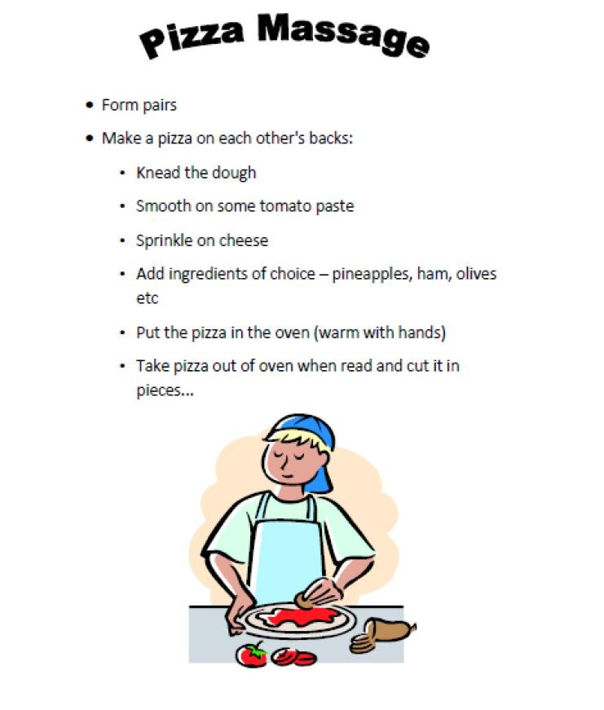
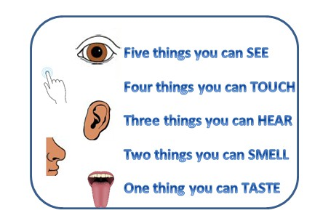
Relaxation and Grounding Techniques

Slide 41
Sleep
Good sleep improves thinking and concentration.
Most Children need 9 to 12 hours' sleep a night
Allow half an hour or so for your child to wind down between studying, plan in things such as a hot bath, reading a book, switching off all technology or listening to soothing music each night before bed and your brain will begin to learn that this is the signal for sleep
Cramming all night before an exam is usually a bad idea. Sleep will benefit your child far more than a few hours of panicky last-minute study.
Remove the phone or electronic devices out of the bedroom – Phone lights are unhelpful -
blue light inhibits melatonin production!
If your child can't sleep, try something relaxing such as this mindful activity:
‘Close your eye and imagine yourself somewhere peaceful, happy and enjoyable. Somewhere that makes you feel relaxed and happy. Focus on that image, start to build the detail and, for a short time, imagine that you are actually there. Breathing slowly and deeply as you do.` (Taken from starving the Exam Stress Gremlin)

Slide 42
Eating Healthy
Eat at regular times, as our body clock is also influenced by eating times
Avoid food too close to bedtime or stimulants like caffeine as they can disturb sleep patterns
Drink plenty of water as our brains work better when hydrated

Slide 43
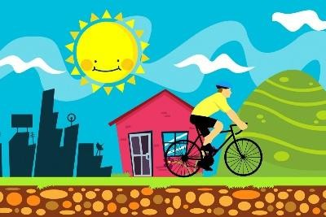
Exercise and ‘ME’ Time
It is really important to also have time away from revising
During this time, you could do some exercise such a hobbies e.g.- Football, Dancing, gymnastics, running etc.
Connecting and having time with friends
By exercising and having ‘me’ time can help you to feel calm, relaxed, positive and help you to think more clearly - to be able to tackle more revision.

Slide 44
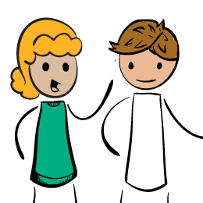
‘It’s good to talk’
Encourage your child to talk about their feelings – this could be to a family member, sibling, teacher or assistant
A problem shared is a problem halved.

Slide 45
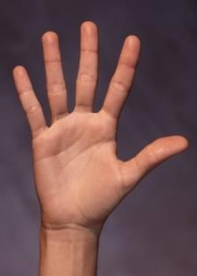
We know 5 things that can help:
Connect - During this time it is good to take time to connect with your family and friends, this could be
playing games, going for a walk with family or watching a movie together. If you feel worried
about exams, then this is a good time to talk to your family or teachers and let them know how you are feeling.
Take notice - Mindfulness can help you slow down and help you to notice what is going on around you.
It can help you to live in the present moment in time – not worry about the past, not worrying about
the future – but appreciating what you have at this present time and being grateful for what is
around you. Why not try some of the breathing exercises such as square or hot chocolate breathing.
Keep learning – You will have been studying lots but why not allow yourself some time from this
learning and challenging yourself to new experiences like learning to ride a bike or setting yourself new goals
Be active – Its important that we need to help our body stay healthy. We can do this by exercising
such as playing football, dancing, walking etc. Exercise can make you feel both physically and mentally healthy.
Give - By simply being kind - Giving cannot just make you feel good inside, but it can bring a smile to
other people too. Giving doesn’t have to cost any money, just by giving someone your time, or by
asking how their day went is a great way to make someone else feel good and improve their wellbeing as well as your own.

Slide 46
Helpful links
Our Healthy Minds Team | (southtynesidelifecyclementalhealth.nhs.uk)
Mental Health Resources for Exams | YoungMinds
Academic and exam stress : Mentally Healthy Schools
Help your child beat exam stress - NHS (www.nhs.uk)
Assessment stress and pressure | Childline

